Slide 1

Microsoft Excel 2013
Dr. Wameedh. T.M. Al-Tameemi

Slide 2
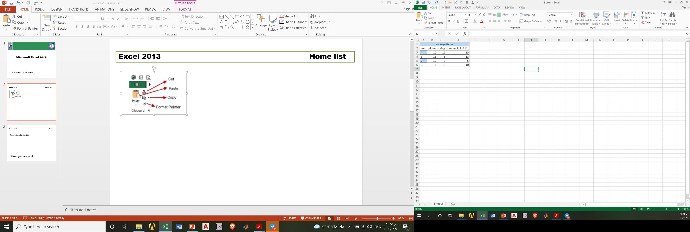
Excel 2013 Home list

Slide 3
Excel 2013 Home list

Slide 4
Excel 2013 Enter and Format Data
Create Spreadsheet
item | winer | spring | summer | autumn
A | 10 | 12 | 14 | 16
B | 20 | 18 | 19 | 15
C | 25 | 30 | 35 | 40
D | 100 | 120 | 80 | 90

Slide 5
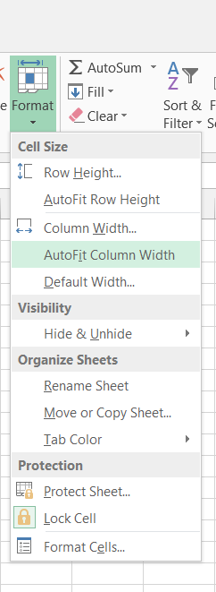
Excel 2013 Enter and Format Data
Adjust Column Width
Initially all columns have the same width in a spreadsheet. Often you will need to make columns wider or narrower. For example, a long text entry in one cell will be cut off/truncated when the cell to its right contains any information. Likewise, numbers will appear as pound symbols ### when larger than cell width. There are several ways to modify column width.

Slide 6
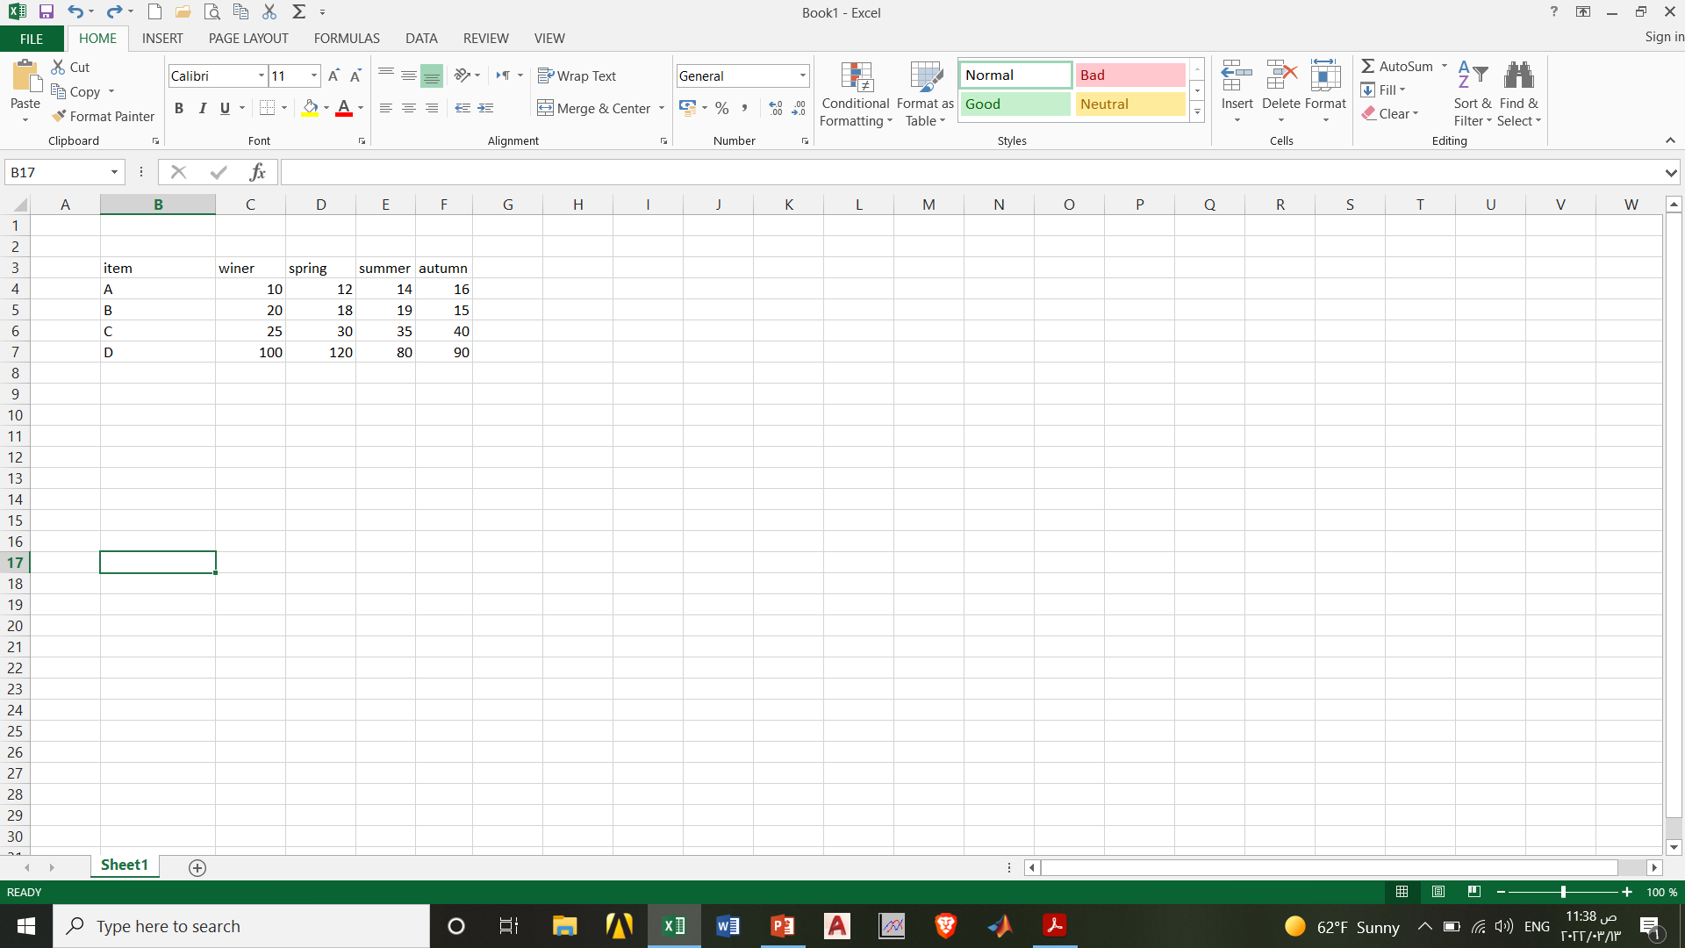
Excel 2013 Enter and Format Data
Type Text and Numbers
Use the plus sign mouse pointer to select a cell then begin typing in that cell to enter data. If there is existing text/data in a cell, the new text will replace the existing text. Press the Enter or Tab key after typing text in a cell.
Undo and Redo
Use the Undo button to undo (reverse) previous actions in reverse sequence. Choose this option immediately after performing an unwanted action. Note that Undo is not available for all commands. The Redo button will restore the process that was just undone

Slide 7
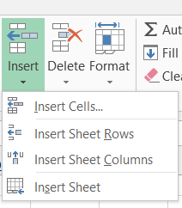

Excel 2013 Enter and Format Data
Insert and Delete Rows and Columns
Insert rows and columns to add information between existing rows or columns of information.

Slide 8
Excel 2013 Enter and Format Data
Text and Number Alignment
Microsoft Excel aligns data in a cell in three ways; left, center, and right. Also, a range of cells can be merged into one cell; this is good for text titles. The default text alignment is left, and the default number alignment is right. Alignment can be changed by using the alignment icons located on the Home ribbon in the Paragraph group. Select a range before changing alignment to more than one cell at a time.
Format Fonts
Character formats include changing the font, point size, and style of text or numbers. The fastest way to change fonts is to use the associated buttons on the Home ribbon:
Note: To select all cells on a worksheet, click the gray rectangle in the upper-left corner of a worksheet where the row and column headings meet. Once you select the worksheet, any format change you make will affect the entire sheet.

Slide 9
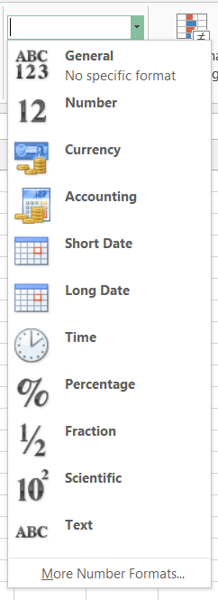
Excel 2013 Enter and Format Data
Format Numbers
Excel provides many different types of numeric formats including currency, percent, comma, scientific, etc. On the Home ribbon the numeric formats are located in the Number group. Select the drop-down arrow next to General to view all format types. Select a range of cell/s before choosing format. In fact, this range can include cell/s that does not yet contain data.
Note: To remove a number format from cells, select the General format option from the Number group

Slide 10

Excel 2013 Enter and Format Data
Cut, Copy, and Paste Text
Avoid retyping in Excel by moving or copying text and formulas. The following list includes commands and definitions involved in cut, copy, and paste.
Note: When you copy a range, a moving border with appear around the selected area. Once you paste the data to remove the moving border, double click in any cell outside of the selected range.

Slide 11
Excel 2013 Next
Next lecture: Insert list
Thank you very much

